Slide 1
Root Cause Analysis
Dana Franz, Mississippi State University
Alyson Lischka, Middle Tennessee State University
Wendy M. Smith, University of Nebraska-Lincoln
October 15, 2025

Slide 2
Session Goal
To learn how the use of the Networked Improvement Community (NIC) Design model for Root Cause Analysis can guide systemic change efforts.
Notes:
Wendy

Slide 3
Workshop Norms & Expectations
Expectations
Active involvement results in more learning
We are sharing a process you can apply, but are not CTE experts
Active listening (listening to understand, not just formulate a reply)
Engaging in a root cause analysis is inherently an exercise in vulnerability
One workshop will outline processes/get you started, but not be enough to finish
Norms
Stay muted in the large group unless you are sharing or asking a question
Cameras on in small groups if possible
No “wrong” ideas in brainstorming
Stories stay--lessons learned go with you
Ensure you’re hearing from all voices
Notes:
Wendy

Slide 4
Who are we?
Mathematics education researchers
Experience as higher education administrators
Part of research-practice partnerships and large federal grants
Lead institutional change efforts
Long-standing partnerships with local community colleges, and research about what makes effective university-community college partnerships to support STEM student transfer
Notes:
Wendy

Slide 5
The Networked Improvement Community (NIC) Design
Four characteristics:
Focused on a well-defined aim
Guided by a clear plan of action (Driver Diagrams)
Disciplined by the rigor of improvement science (Plan-Do-Study-Act cycles)
Networked to accelerate progress
Notes:
Wendy
Improvement Science method - proven to enact change in educational systems
Connect to the Root Cause Analysis

Slide 6
What is a Root Cause Analysis?
It is the process of analyzing the complex systems within our organization to help answer the question:
“Why do we get the outcomes that we currently do?” (p. 66)
(Bryk, Gomez, Grunow, LeMahieu, 2015)
Notes:
Alyson
Lots of stakeholders, institutions-will have many ideas/thoughts about the causes. Will need to come to agreement.

Slide 7
What is a Root Cause Analysis?
During the process:
Large and often broad problems are initially identified, but
These large problems are just too broad to tackle
THEREFORE
Brainstorming is needed to identify the many factors that contribute to the large problem
This process continues until specific, manageable targets
are identified
Notes:
Alyson

Slide 8
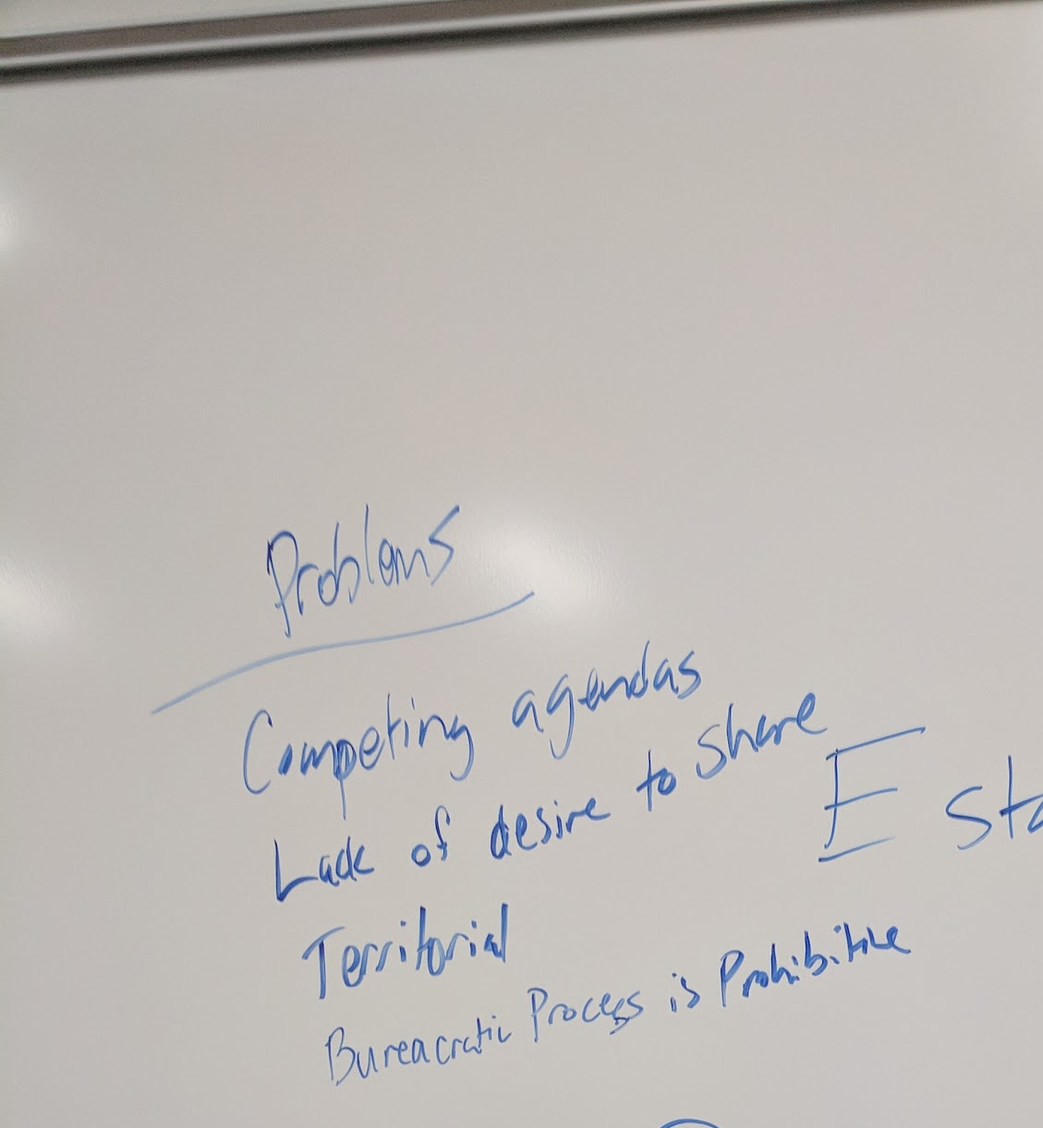
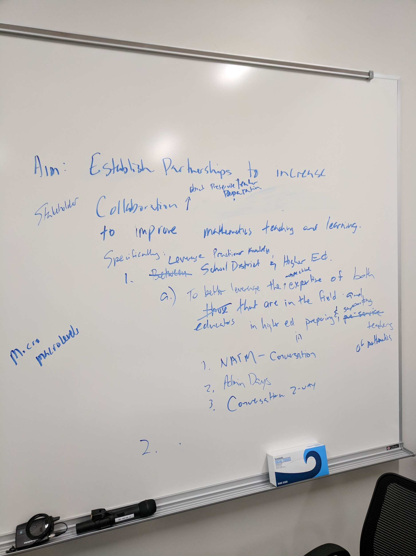
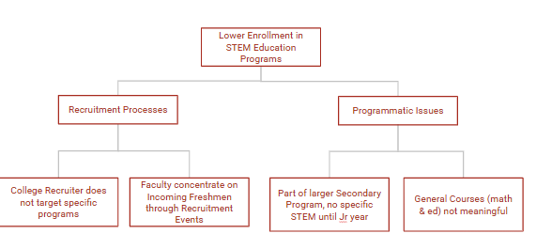
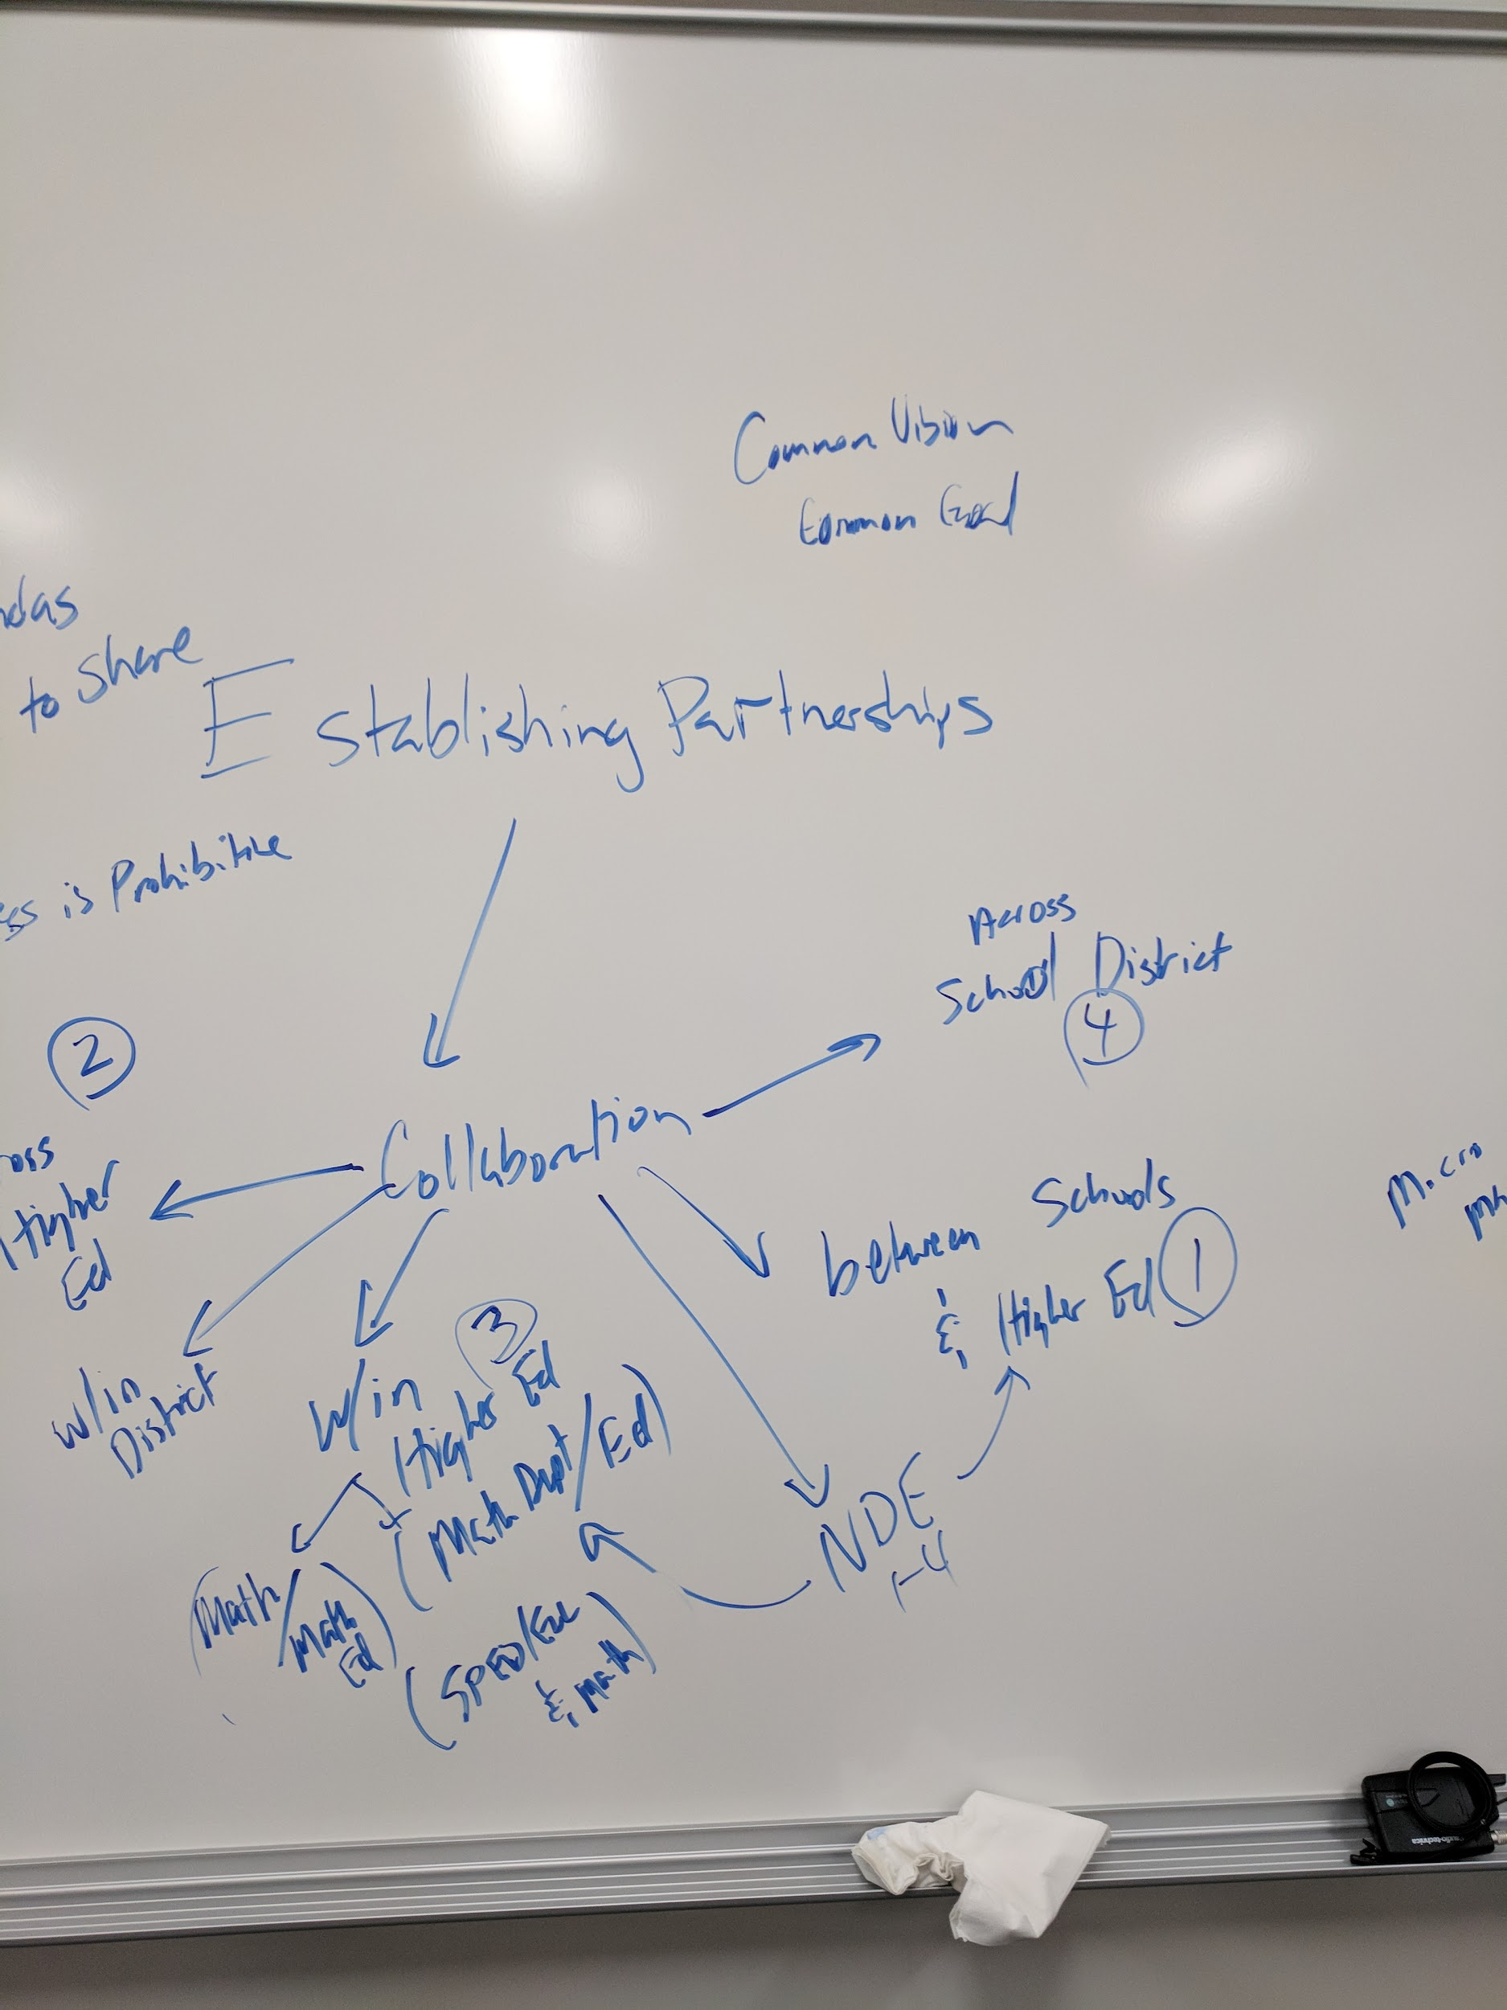
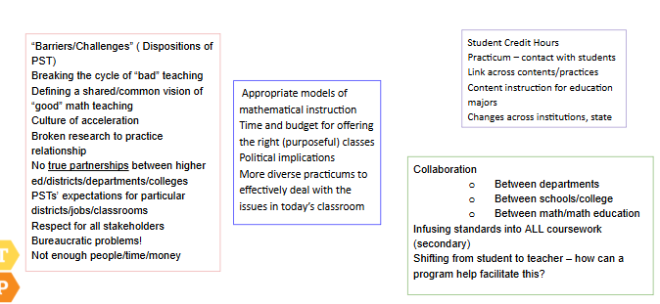
Images of Root Cause Analyses
Notes:
Alyson
This is what a full Root Cause analysis can look like

Slide 9
A Short Example to Get Started
In your small group, choose an issue (based on your data):
Not enough CTE majors.
Low retention or graduation rates for CTE majors.
High drop/fail/withdraw rates from CTE courses.
Lack of use of equitable teaching practices in CTE courses.
Local colleges & universities not accepting community college CTE courses for transfer.
Brainstorm (record your ideas):
  Why does this occur?
  What is it contributing to the problem?
  There is not just one cause - keep going!
  If you think you are done - drill down further!
Notes:
Dana
10 minutes to brainstorm - 5 minutes to share out
Ask for one or two groups to share their topic and one of the last items on their brainstorm list.
Discuss - are your final items targeted and manageable?

Slide 10
Breakout Rooms
In 10 minutes, we don’t expect you to get all the way drilled down to root causes
Share some problems you identified in your data
Select a problem to explore as a group
Brainstorm possible causes
Drill down to what could be underlying causes
Pick a person to share out in the chat when the breakout rooms end (and be ready to speak if called on)
Notes:
Dana [Wendy will set up the breakout rooms]

Slide 11
Sharing out from Groups
Have your designated representative type in the chat:
your topic, and
one root cause you landed on
Notes:
Dana

Slide 12
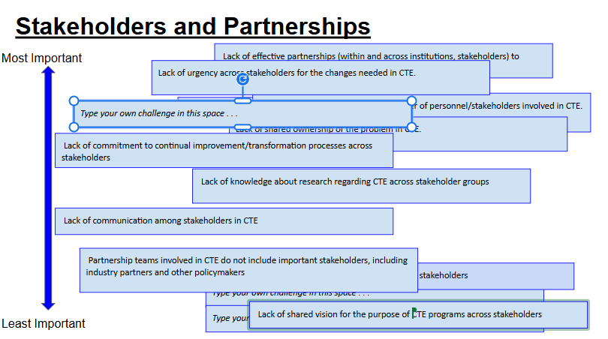
Root Cause Analysis Card Sort
Notes:
Alyson
Example of one way to complete a root cause analysis - if you have data on causes to draw from.
https://docs.google.com/presentation/d/1UPZ8S1TqQU2T6CY1KetShFwjDaovnNR_mOaDUmwn_-s/copy?usp=sharing

Slide 13
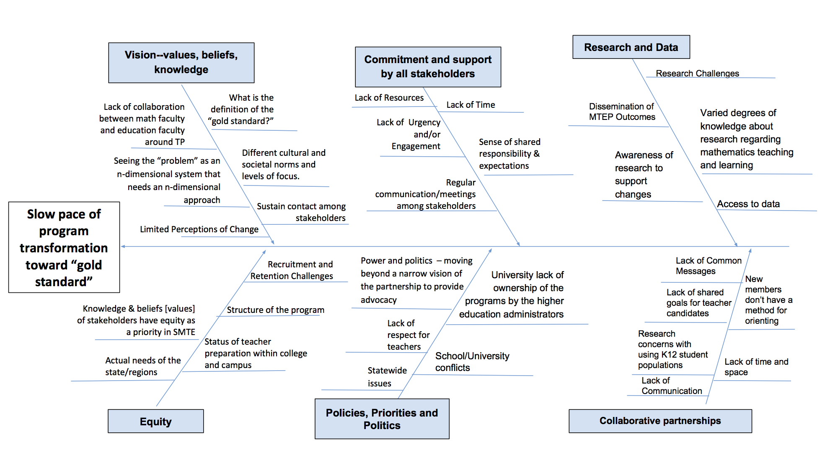
Fishbone Diagram - Root Causes
Find a way to organize
Notes:
Alyson
Record of your root cause analysis brainstorming serves as one communication tool - returning to it can help your community communicate about mission and reasons for that mission.

Slide 14

Now that you have prioritized root causes...
Notes:
Wendy

Slide 15
Create a Measurable Aim
By [DATE], [name of partnership] will improve [target outcome] by [measurable amount].
Notes:
Wendy

Slide 16
Record your Theory of Action:
Driver Diagrams (one of many formats)
Shared understanding of priorities and change levers
Clear connections between root causes, hypothesized change levers, and change strategies
Avoid mission creep
Regularly revisit these as progress is made or the contexts change
Notes:
Wendy

Slide 17
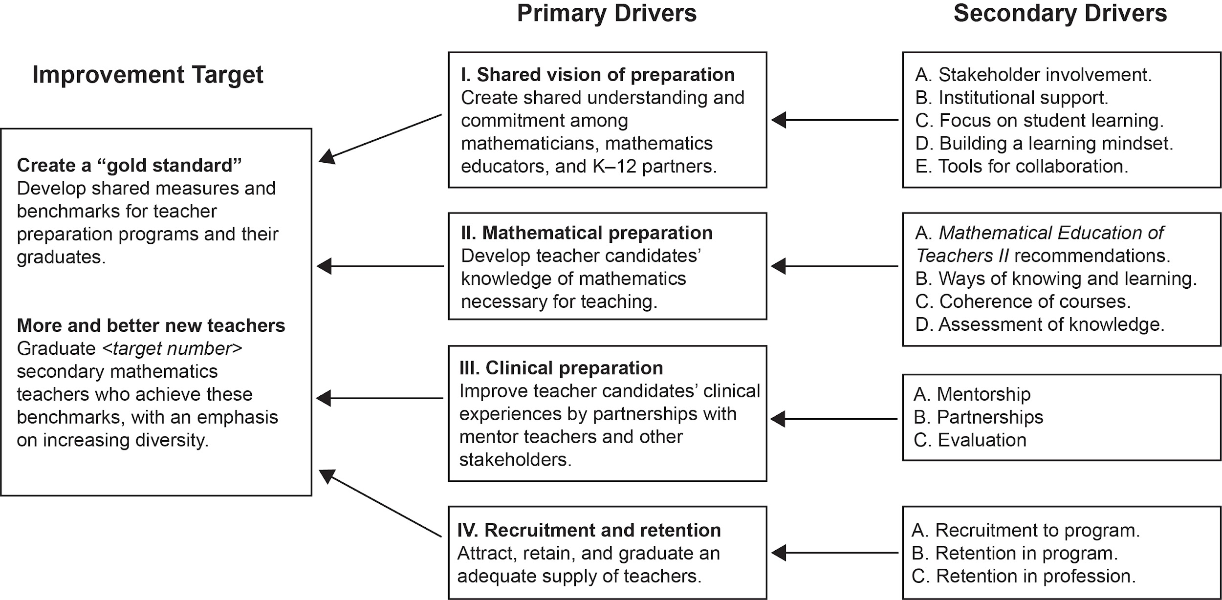
Driver Diagrams
Focused Aim
What: Primary Drivers
Where: Secondary Drivers
How: Change Strategies
The goal... the levers for change... finer-grained levers... how you will do it
Notes:
Wendy

Slide 18
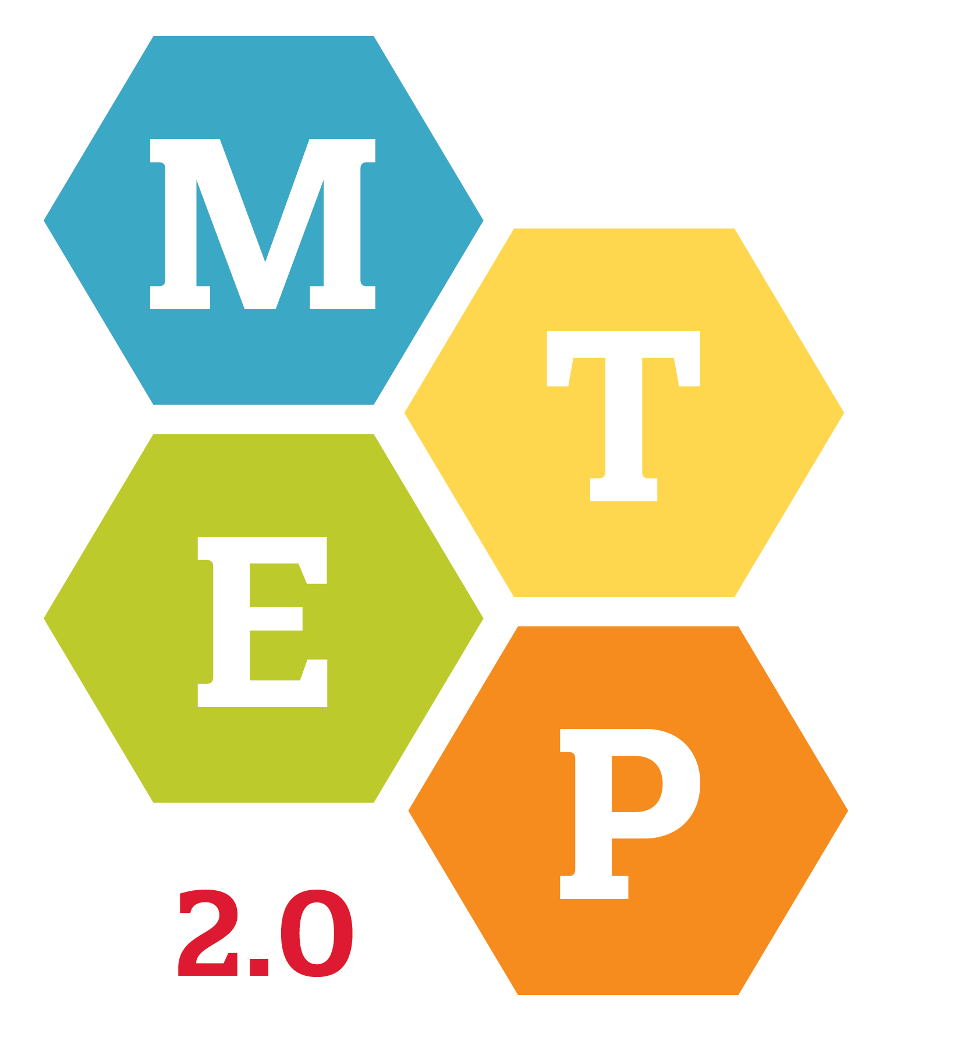
MTEP 2.0 Driver Diagram
Secondary Drivers (WHERE)
Support Hub ← Change Ideas
Primary Drivers (WHAT)
Developing and supporting the change agents as NIC leaders
Change agents. Developing change agents—leaders of local Program NICs and other leaders—to support equitable transformation both locally and across the MTEP 2.0 network.
Supporting the improvement efforts of the NICs (process and product)
AIM
Building connections among Program NICs to support shared improvement work.
By 2026,
65 MTEP programs, including 11 historically under- resourced and/or MSIs,
will be actively engaged in an explicit, localized, prioritized improvement process toward alignment with the AMTE Standards and MTEP Guiding Principles,
in order to increase the number of well-prepared beginning secondary mathematics teachers,
while foregrounding issues of equity and access both in the objectives and practices of the programs.
Knowledge sharing. Generating, capturing, and promoting knowledge garnered from the improvement efforts that will be useful to MTEP 2.0 teams and others engaged in transforming secondary mathematics teacher preparation.
Share data and findings internally
RQ1 Study how MTEP supports partnerships
Knowledge building. Building knowledge about overall program transformation, as well networks of NICs following a NIC of NICs design working on common problems of practice to support program transformation.
Research Hub ← Change Ideas
Cross Hub Communication & Administrative Hub ← Change Ideas
RQ2 Study how MTEP supports change agents
Share findings externally
Network building. Scaling up and nurturing a national network of Program NICs that facilitates the work of the Program NICs.
Recruitment of MTEP 2.0 membership,
with special attention to MSIs and under-resourced institutions
Nurturing a national network to support MTEP 2.0 goals
Responding to context. Engaging stakeholders across Program NICs in creating, assessing, and responding to policies that impact program improvement at all levels.
Engaging stakeholders in creating, assessing, and responding to policies, with special emphasis on DEI issues
Outreach. Building external awareness and support of the MTEP network.
Building public awareness and support of the MTEP 2.0 network
Outreach Hub ← Change Ideas
Notes:
Wendy
Discussion point: In what ways might a Driver Diagram serve as a tool in a change partnership?

Slide 19
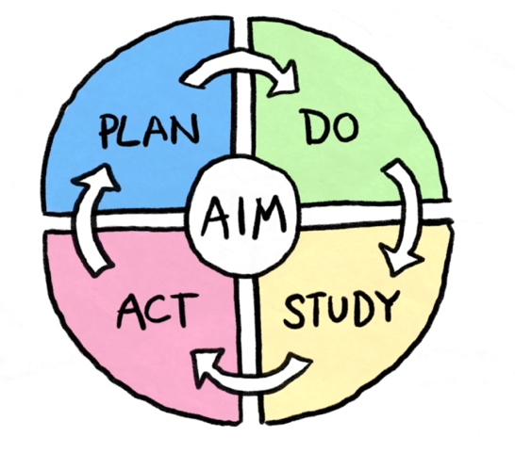
PDSA Cycles
They are the key mechanism by which we learn in improvement.
They provide a way to test and revise your theories at an appropriate scale.
You often gain more by doing something (even if it’s small) rather than obsessing over getting it “right “ from the start.
They give us a common approach what we can use to discipline our efforts, so we are efficient.
Notes:
Dana

Slide 20
Considerations for Data in PDSA
What data can inform you in the short term?
In common, not in common
Classroom, course, campus levels
Ensure you are capturing student voices
“Autopsy” data gives longitudinal trends but not in-the-moment actions
Notes:
Dana

Slide 21
Revisit: Who Might Your NIC Include?
Faculty/administrators from multiple institutions?
Faculty/administrators from multiple colleges or departments within an institution?
K-12 school partners?
Industry representatives?
State level personnel?
College students?
Other relevant internal or external partners (special education, language teachers, field supervision, regional personnel, education ministry personnel, etc.)
Notes:
Alyson

Slide 22
Recap: Steps in Building a Networked Improvement Community (NIC)
1. Establishing the community
2. Defining the problem space - Root Cause Analysis
  Focused on a common aim
  Guided by deep problem analysis
3. Disciplined inquiry based on continuous improvement
4. Networked to accelerate progress
Notes:
Alyson

Slide 23

Questions?
Notes:
Alyson

Slide 24

Resources
Learn More about MTEP: https://scimath.unl.edu/mtep/
Bryk, A. S., Gomez, L. M., Grunow, A., & LeMahieu, P. G. (2015). Learning to improve: How America’s schools can get better at getting better. Harvard Education Press.
Elrod, S., Kezar, A. & Gonzalez, A. (2023). Change leadership toolkit: A guide for advancing systemic change in higher education. USC Rossier: Pullias Center for Higher Education.
Martin, W. G., Lawler, B. R., Lischka, A. E., & Smith, W. M. (2020). The Mathematics Teacher Education Partnership: The Power of a Networked Improvement Community to Transform Secondary Mathematics Teacher Preparation. Information Age Publishing.
Notes:
Alyson

